Slide 1
Welding: Concept and Classification
Lecture 8

Slide 2
Introduction to Welding
Welding is a materials joining process in which two or more parts are coalesced at their contacting surfaces by suitable application of heat and /or pressure.
Some welding processes are accomplished only by heat, no pressure is required; some processes require both heat and pressure; remaining only pressure, with no external heat.
Some welding processes require filler material to facilitate coalescence.
The assembly of joined parts by welding is called a weldment.

Slide 3
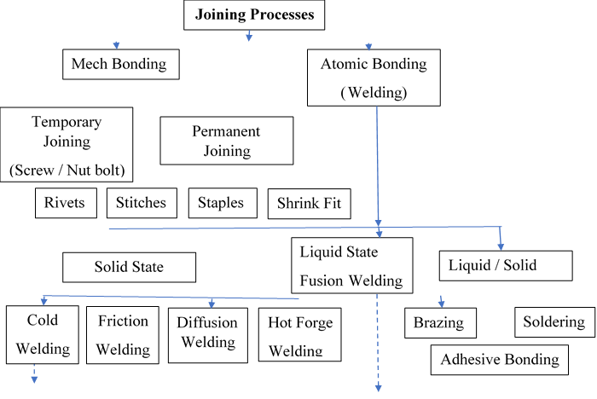
Classification of Metal joining Processes
Classification of Metal Joining Processes [1] Contd…

Slide 4
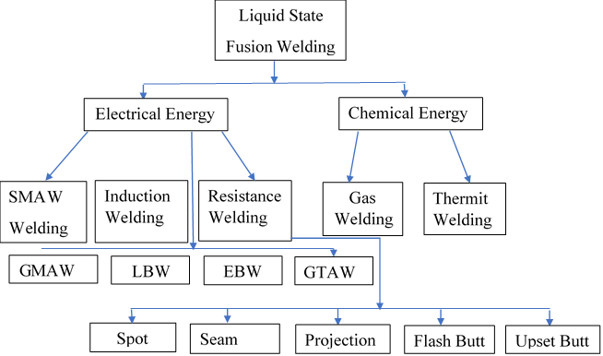
Classification of Metal joining Processes
Classification of Metal Joining Processes [1] Contd…

Slide 5
Classification of Metal joining Processes
Classification of Metal Joining Processes [1] Contd…
Cold Welding
Pressure Welding
Ultrasonic Welding
Explosive Welding

Slide 6
Sources of Energy in Welding Processes
Chemical energy: Gas welding, explosive welding, Thermit welding
Mechanical energy: Friction welding, Ultrasonic welding
Electrical energy: Arc welding, Resistance welding
Radiation energy: Laser beam welding, Electron beam welding

Slide 7
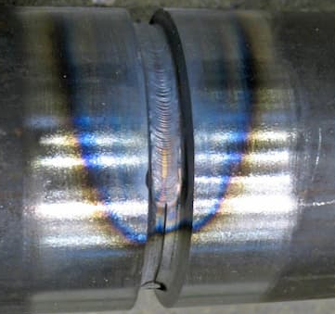
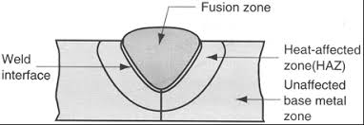
Zones at the weld area [2]
Zones at The Weld Area

Slide 8
Zones at the Weld Area
The fusion zone consists of a mixture of filler metal and base metal that have completely melted. This zone is characterized by a high degree of homogeneity among the component metals that have been melted during welding.
The weld interface zone is a narrow boundary that separates the fusion zone from the heat-affected zone. The interface consists of a thin band of base metal that was melted or partially melted (localized melting within the grains) during the welding process but then immediately solidified before any mixing with the metal in the fusion zone
The heat-affected zone (HAZ). The metal in this zone has experienced temperatures that are below its melting point, yet high enough to cause microstructural changes in the solid metal.

Slide 9
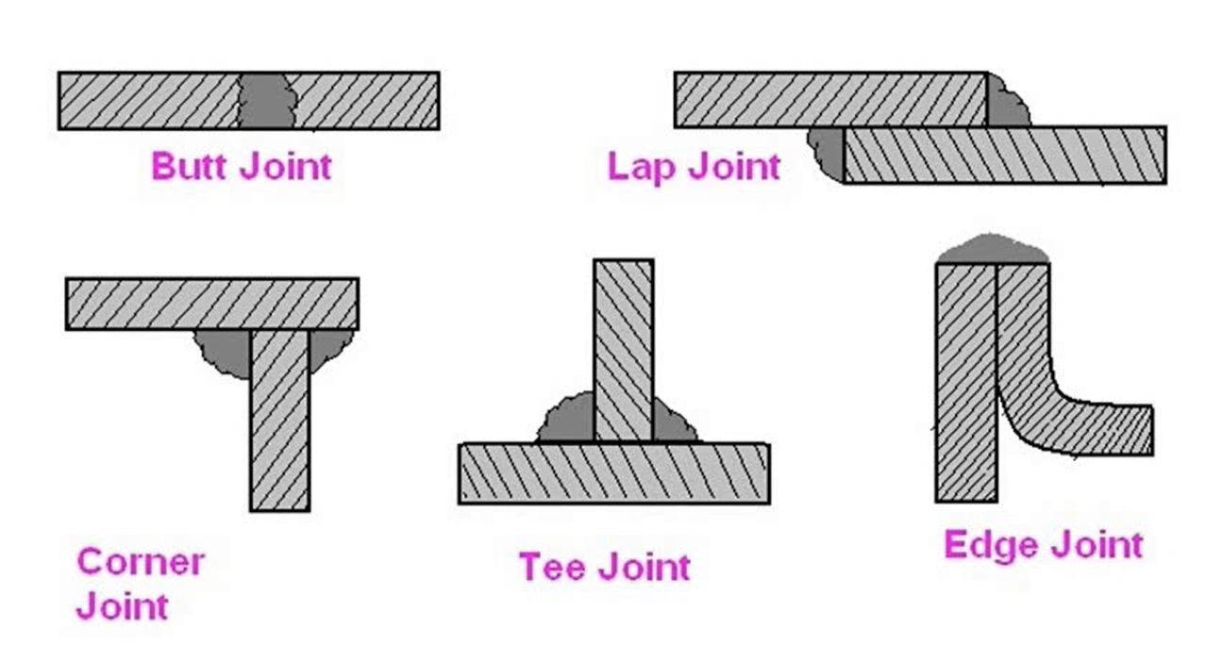
Types of Welding Joints

Slide 10
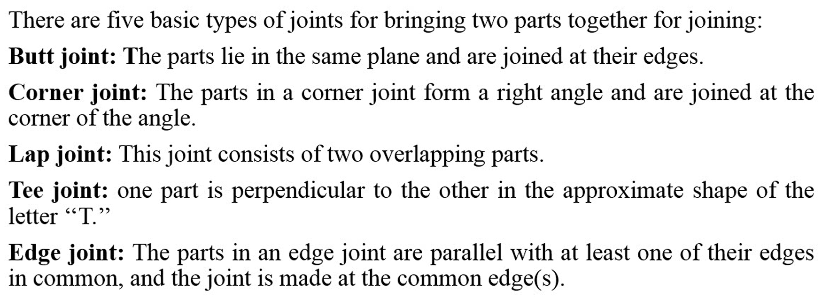
Types of Welding Joints

Slide 11
Common welding defects are: Slag Inclusion Undercut Porosity Incomplete fusion Weld overlap Underfill Weld Spatter Incomplete weld penetration
Welding Defects

Slide 12
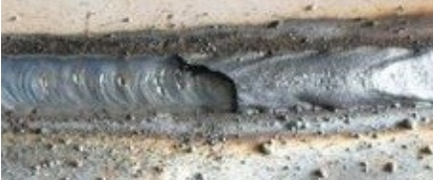
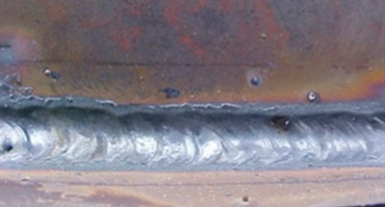
Slag Inclusion Causes: Insufficient Current, Slow Travel Speed Elimination: Proper Current, Appropriate Travel Speed Repair: Removed by Grinding
Welding Defects
Undercut Causes: High current, Improper electrode angle, Long arc length Elimination: Appropriate current, Training to operator Repair: Use smaller electrode

Slide 13
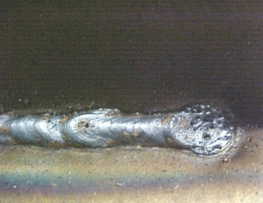
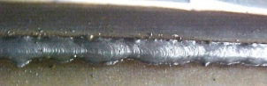
Porosity Causes: Release of trapped gases Elimination: Cleaning of the surface and ends Repair: Removed by Grinding
Welding Defects
Incomplete fusion Causes: Low current, Fast travel speed, Short arc gap Elimination: Appropriate current & travel speed. Repair: Remove and reweld

Slide 14
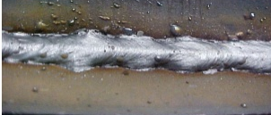
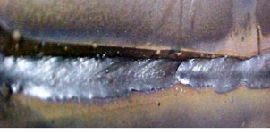
Weld overlap Causes: Untrained operator, Steep electrode angle, Faster travel speed Elimination: Appropriate welding technique Repair: Removed by Grinding
Welding Defects
Underfill Causes: Faster travel speed, improper welding technique Elimination: Use stripper beads before cover pass Repair: Clean and fill by welding

Slide 15
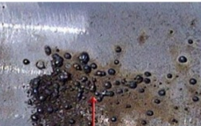
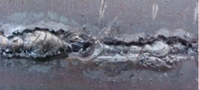
Weld spatter Causes: High arc current, Magnetic arc blow Elimination: Reduce arc current, shorten arc length Repair: Removed by Grinding
Welding Defects
Incomplete weld penetration Causes: Low current, fast travel speed, short arc length Elimination: appropriate current, travel speed and electrode Repair: Clean and reweld

Slide 16
References / Further Readings
[1] Ghosh, A. & Mallik, A.K.; Joining processes, Manufacturing Science, Latest edition.
[2] https://fractory.com/heat-affected-zone-causes-effects-reduction/
[3] Kalpakjian, S & Schmid, S,; Manufacturing Processes for Engineering Materials, Latest edition.

Slide 17


